Slide 1
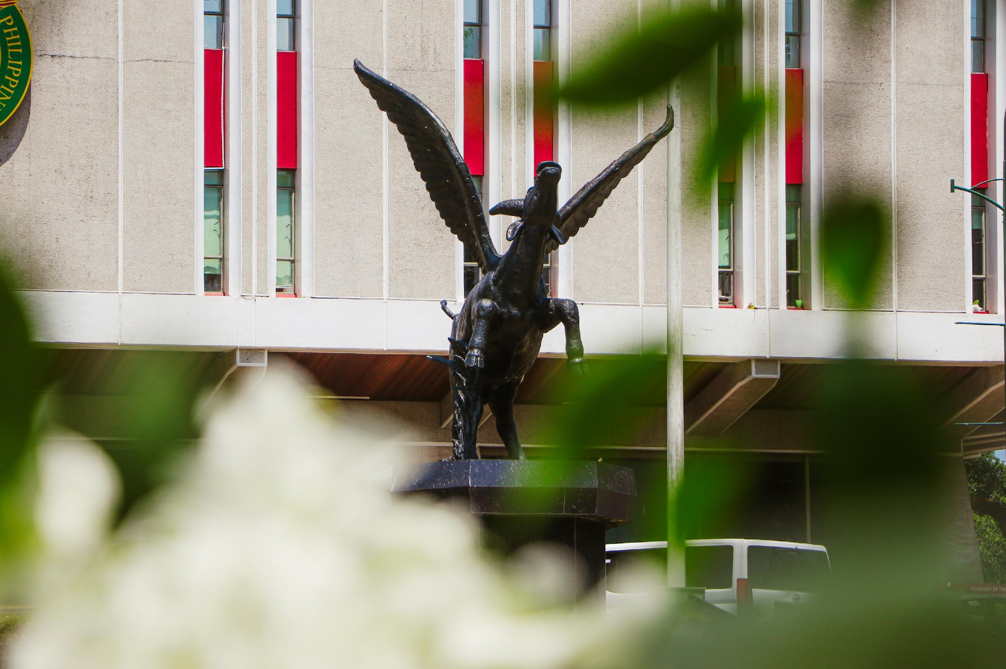


UPLB EASYPAY
Enhanced Automated System for Your Payment and Accounting Yields
Juatco, Jemuel
Institute of Computer Science

Slide 2

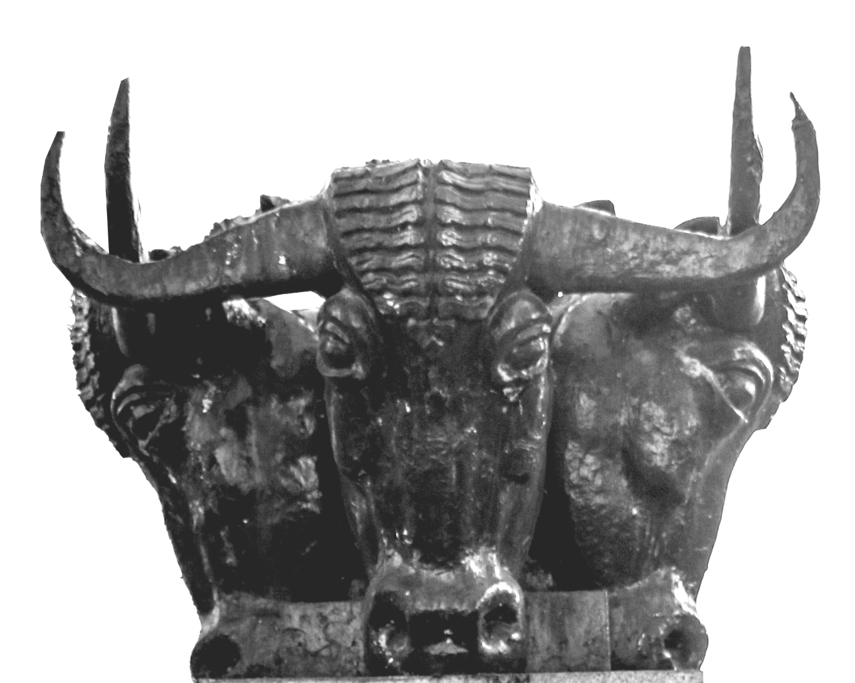
Introduction
The traditional method of cashiering in the univeristy often lead to long queues and inefficient record management.
Some students are not aware of the cut-off time of the cashier’s office.
This system will generally ease the day-to-day cashier operations and give students a chance to have payment reservations.

Slide 3
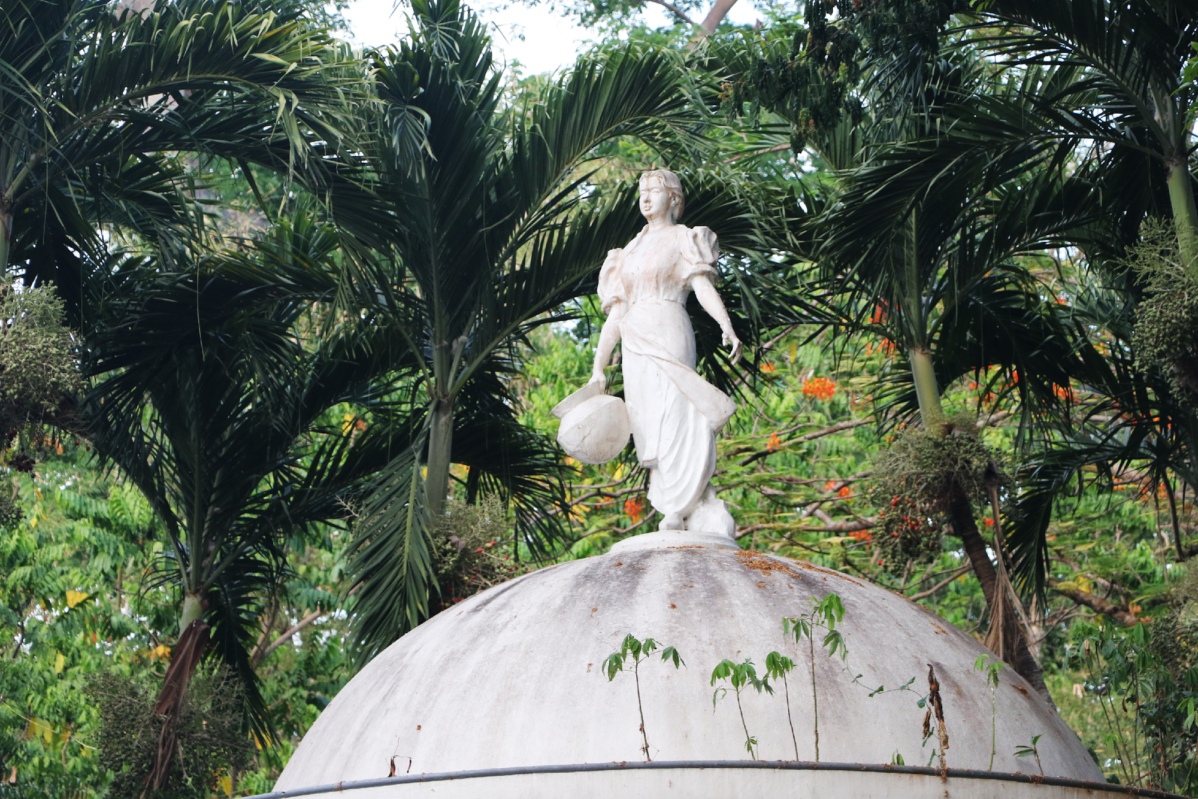
Objectives of the Study
01
To develop a web-based application that focuses on easing the collection process and report generation for the cashier administrators
02
To develop a mobile application that will be used by the UPLB students to make payment appointments to the cashier's office, and;
03
To evaluate the accuracy of the web-based application's output and assess the usability of both the web-based and mobile applications.

Slide 4
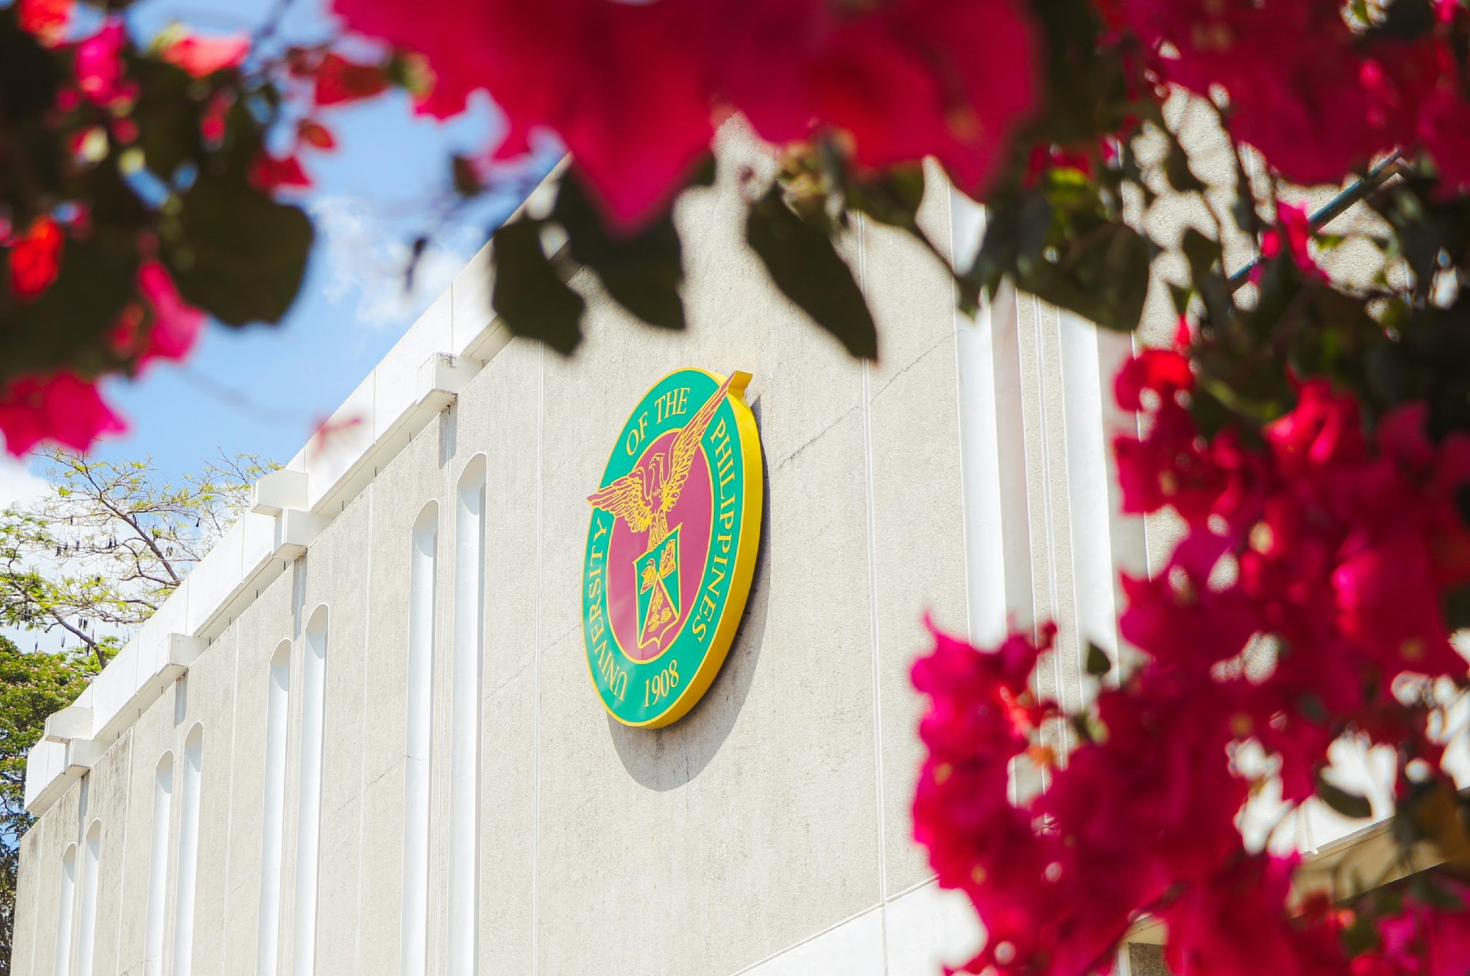
METHODOLOGY

Slide 5
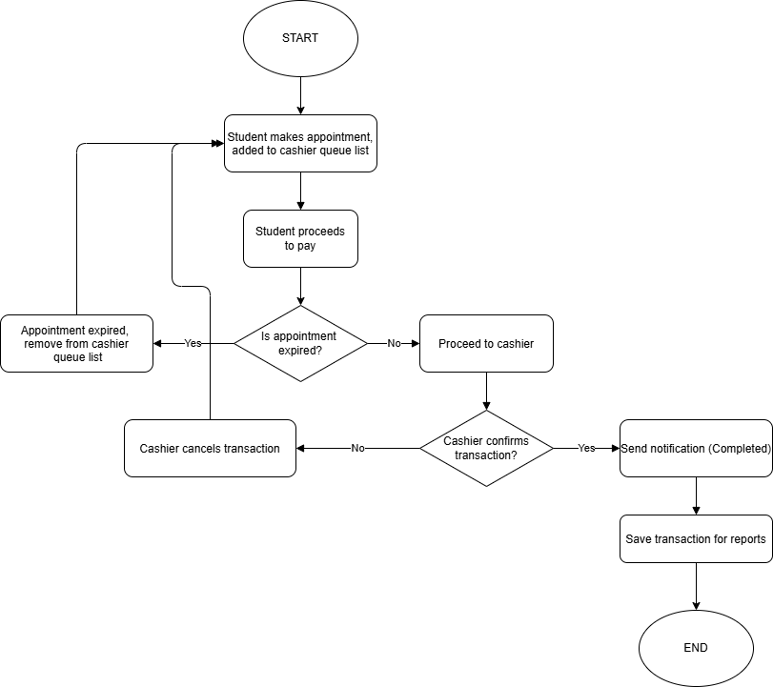
Simple student appointment flowchart

Slide 6
Methodology
Web application (React)
Offline-first approach - application can function offline
Transactions are saved locally using DexieDB with proper encryption using AES
For cashier personnel only

Slide 7
Methodology
Mobile application (Flutter)
Appointment feature using firebase cloud firestore for viewing and tracking queues. Includes automatic cleaning of the database to save storage and maintain functionality
Notifications using Firebase Cloud Messaging (FCM) with device fcmTokens.

Slide 8
RESULTS AND DISCUSSION

Slide 9
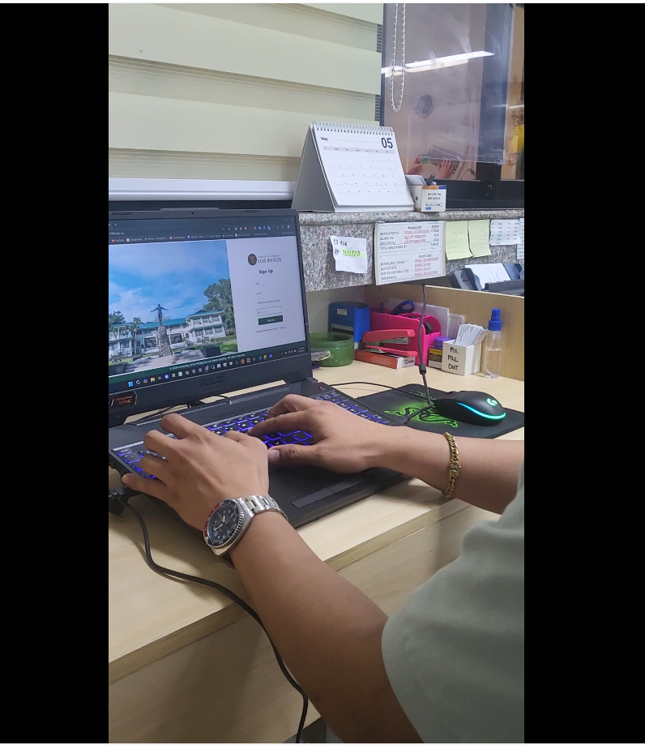
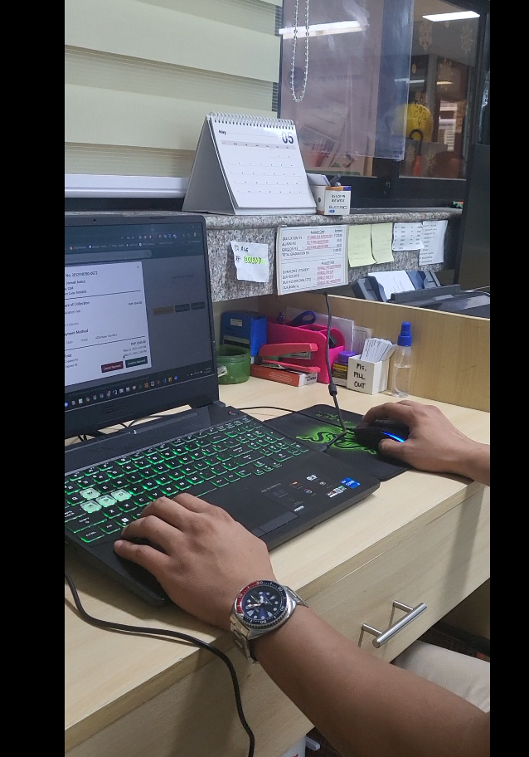
TESTING OF THE APPLICATION

Slide 10
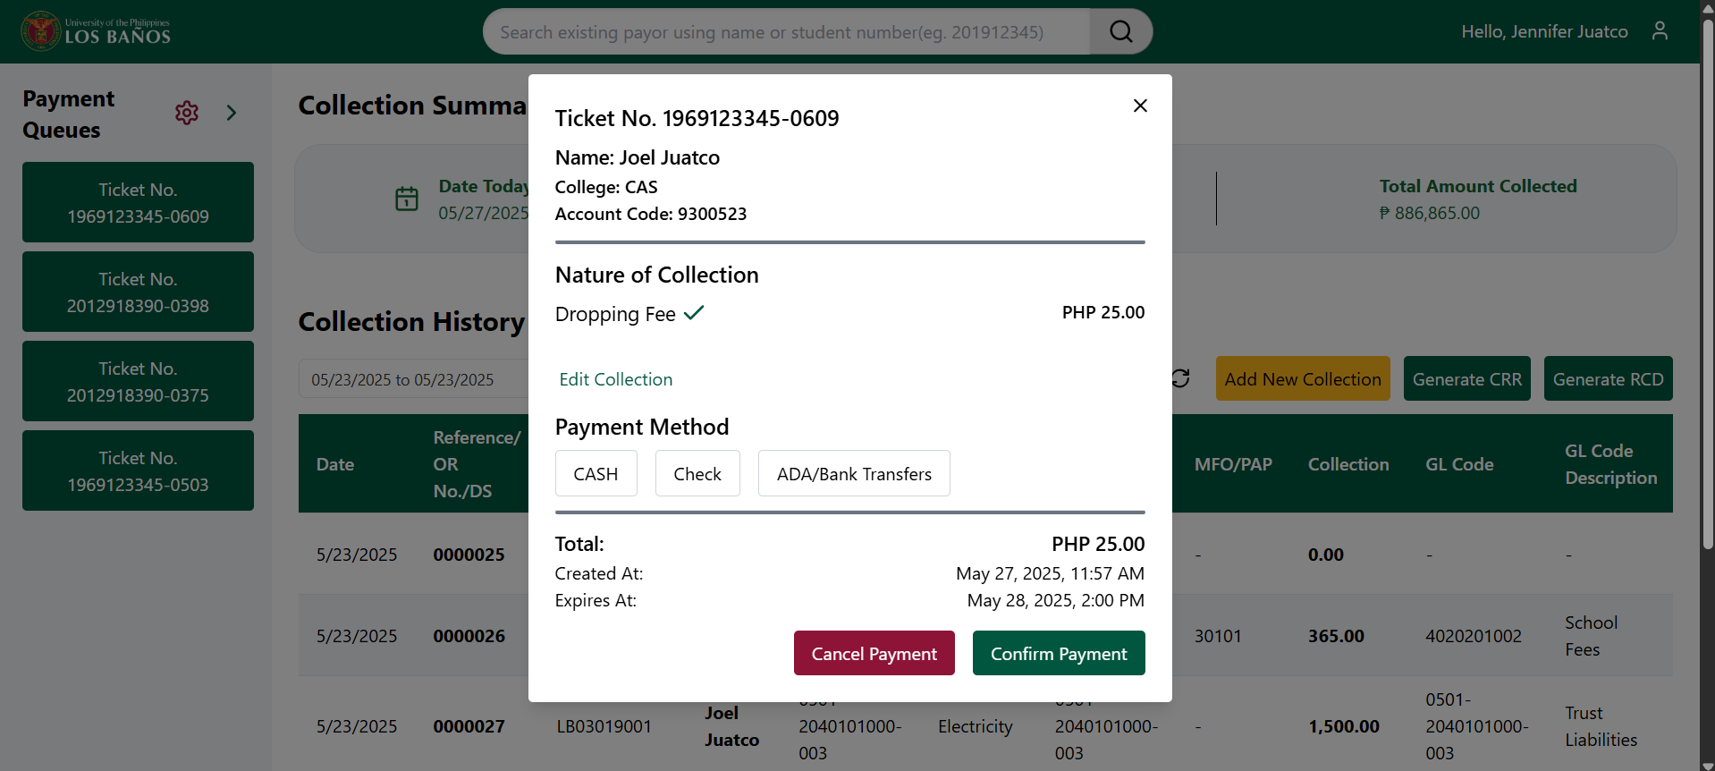
TESTING OF THE APPLICATION

Slide 11
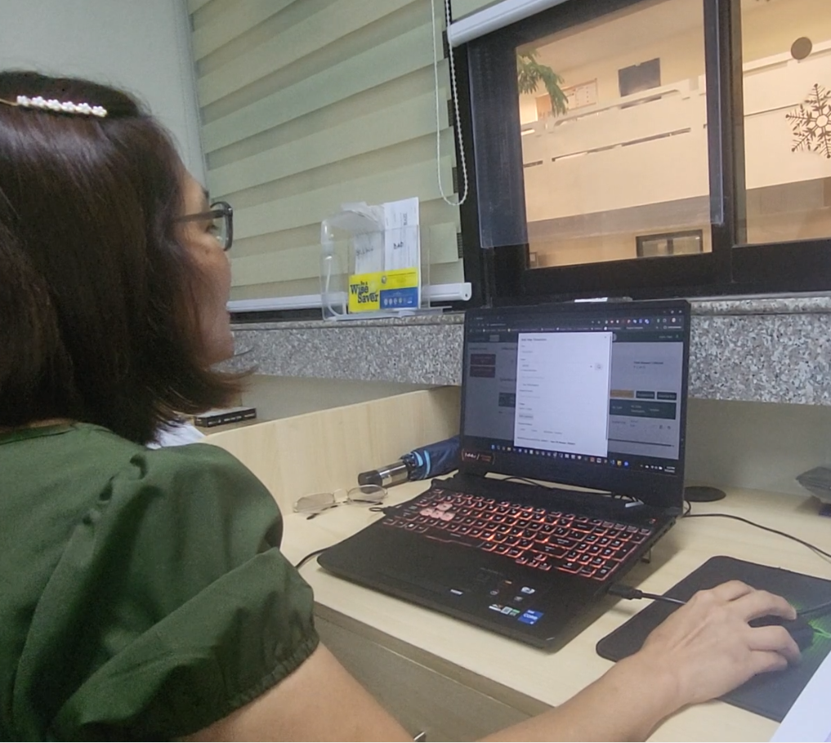
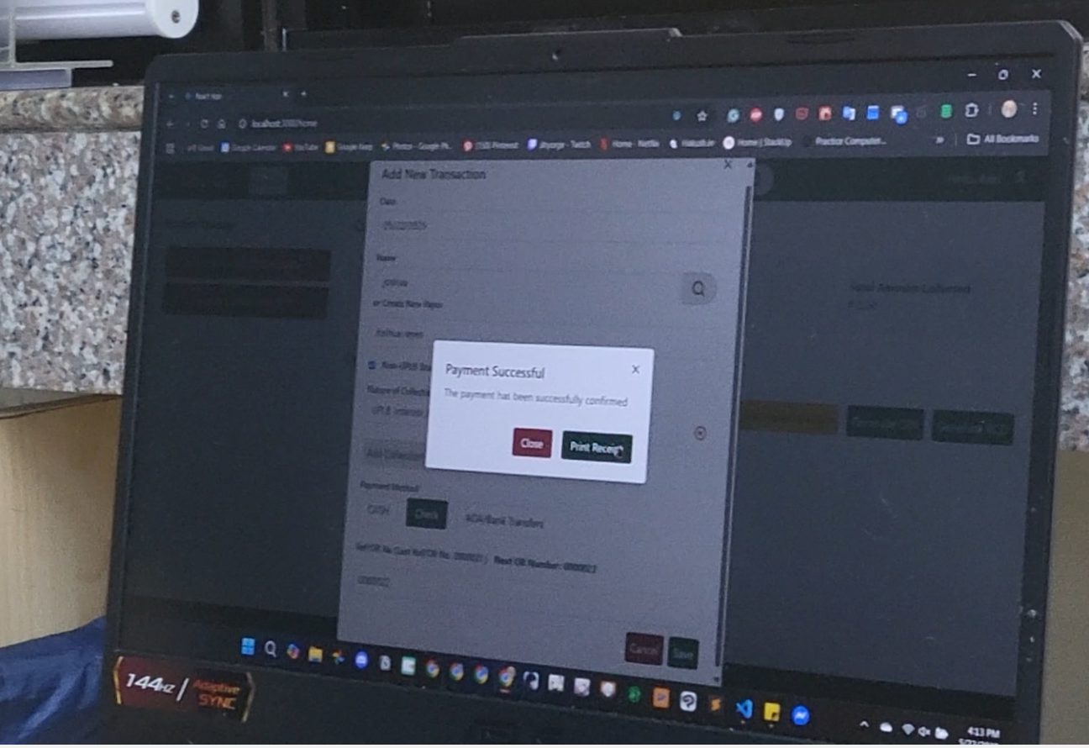
TESTING OF THE APPLICATION

Slide 12
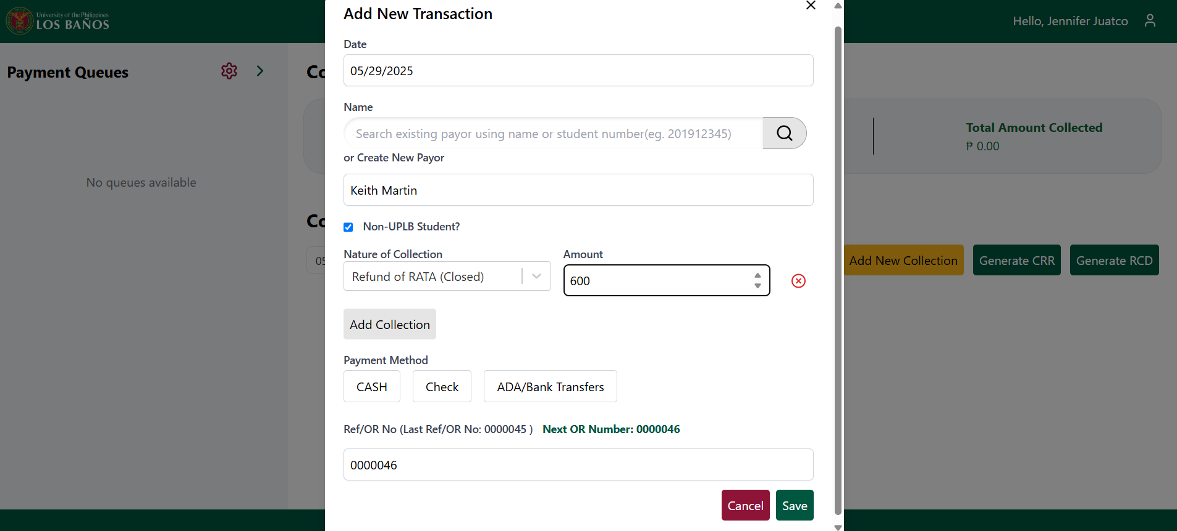
TESTING OF THE APPLICATION

Slide 13
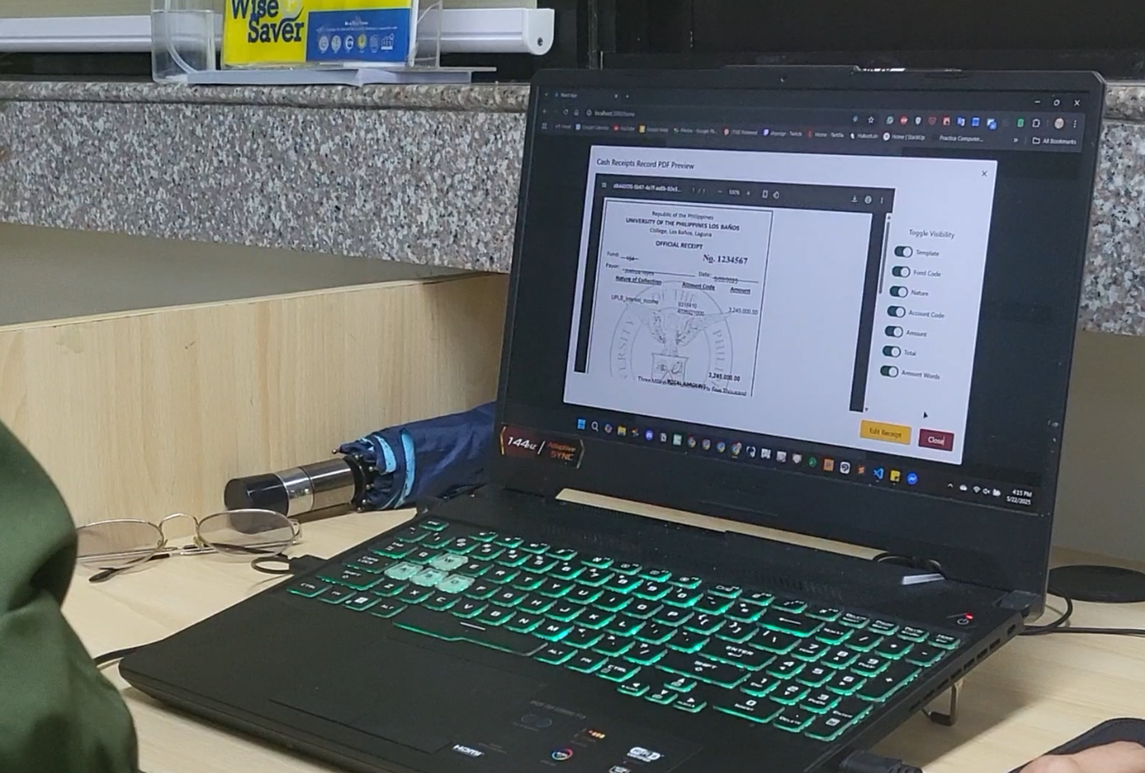
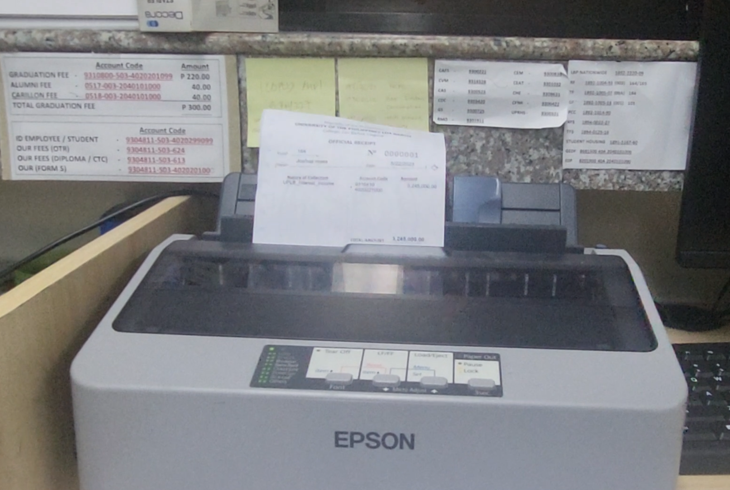
TESTING OF THE APPLICATION

Slide 14
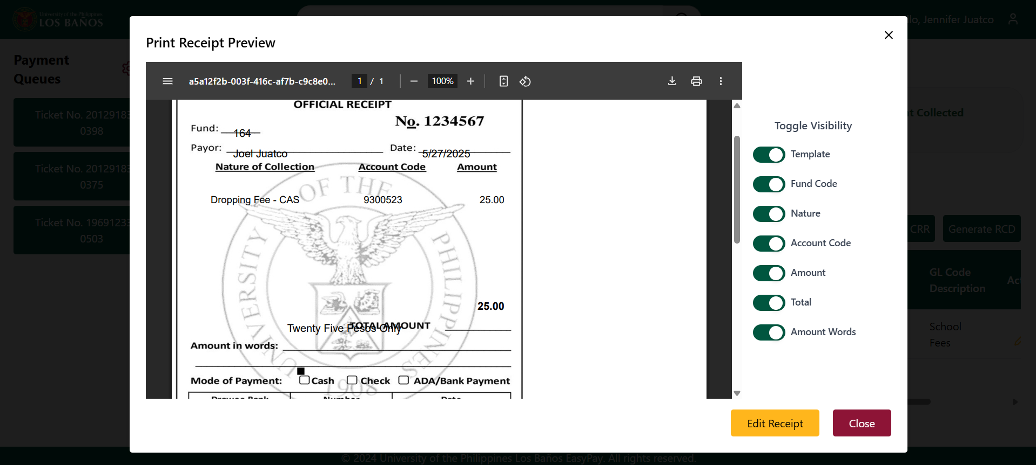
TESTING OF THE APPLICATION

Slide 15
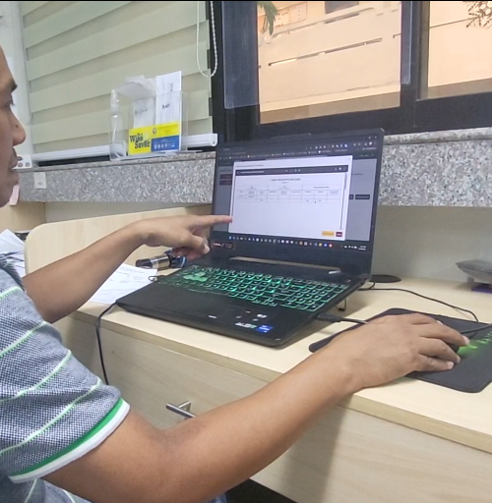
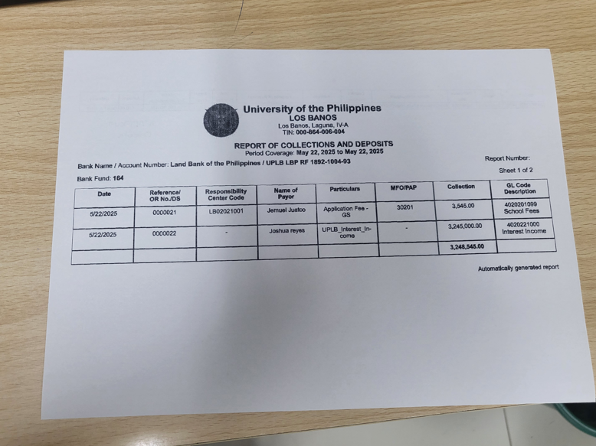
TESTING OF THE APPLICATION

Slide 16
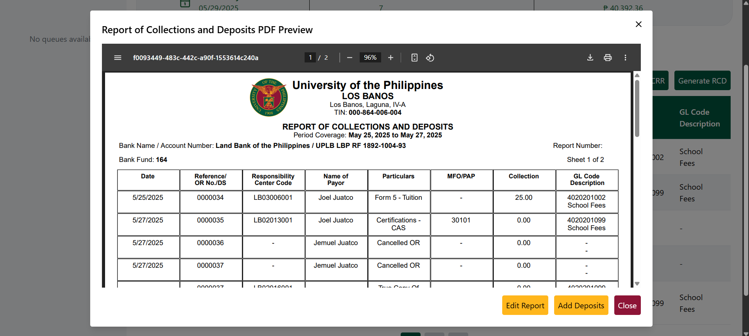
TESTING OF THE APPLICATION

Slide 17
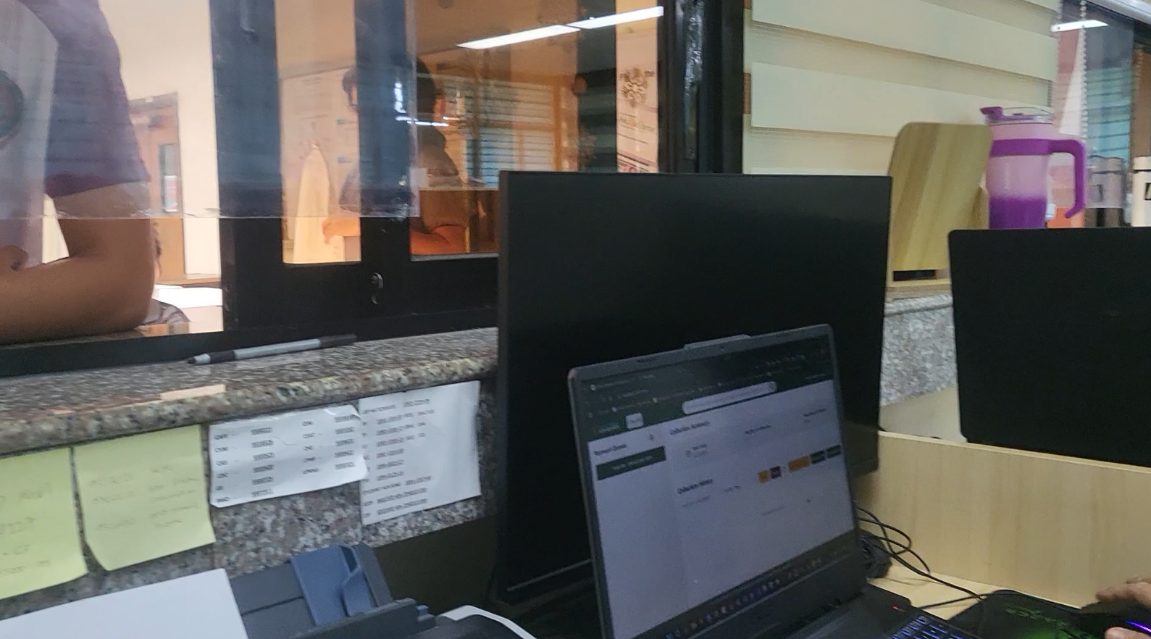
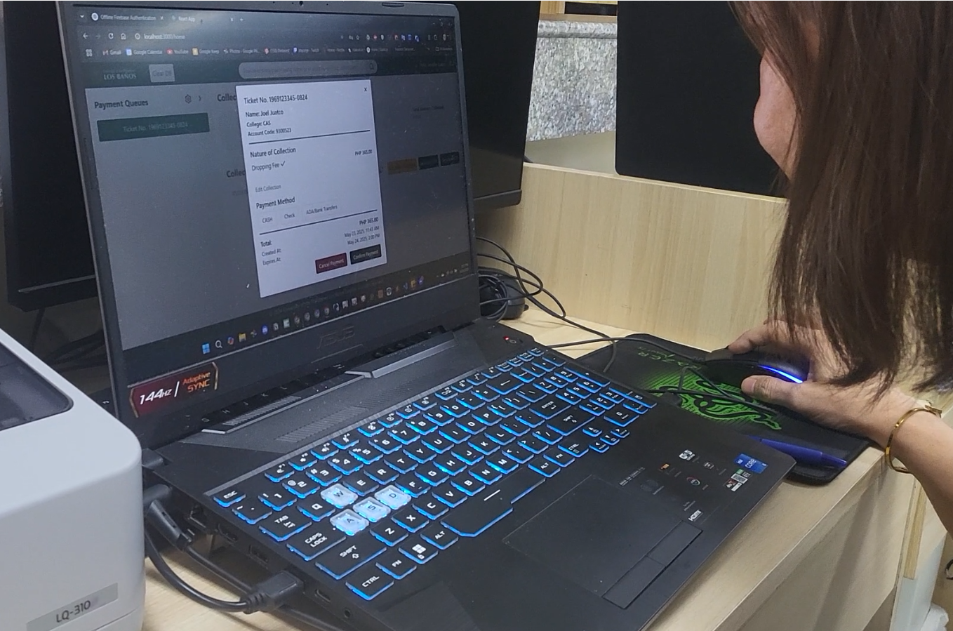
TESTING OF THE APPLICATION

Slide 18
TESTING OF THE APPLICATION

Slide 19
TESTING FEEDBACK
TESTING FEEDBACK
Web-based: Validation testing categorized into 3 sections: ease of use, accuracy of output, and overall functionality and behavior. Open feeback is included as well.
10 Participants (4 cashier admins; 6 cashier personnel)
Mobile application used SUS scale
20 diverse UPLB students

Slide 20
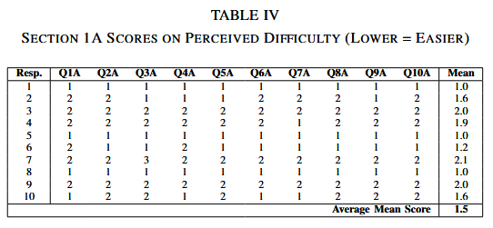
RESULTS WEB RESULT

Slide 21
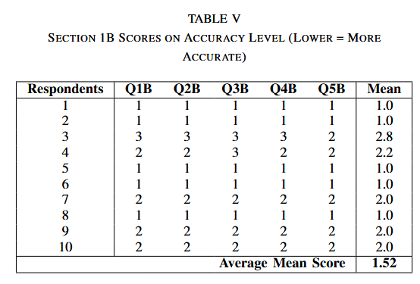
RESULTS WEB RESULT

Slide 22
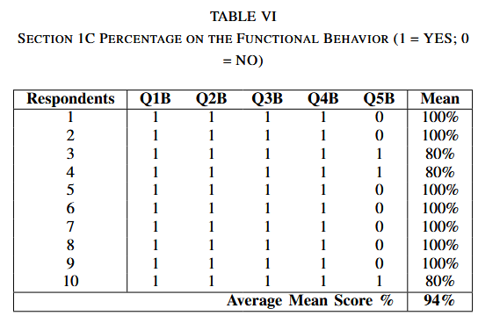
RESULTS WEB RESULT

Slide 23
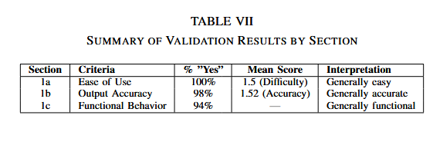
RESULTS WEB SUMMARY

Slide 24
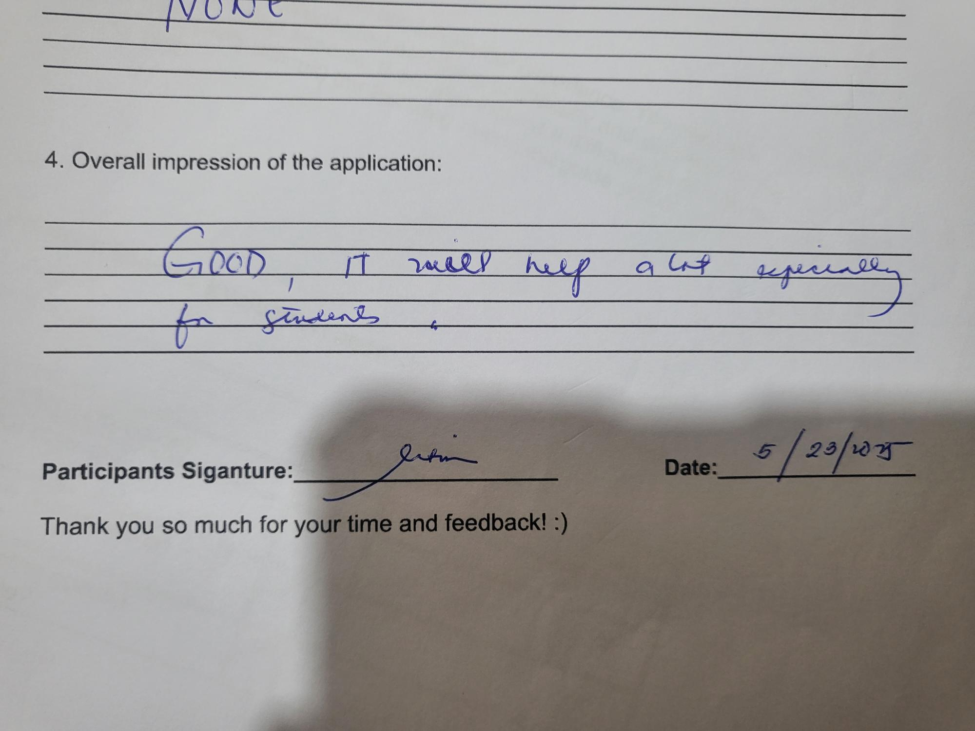
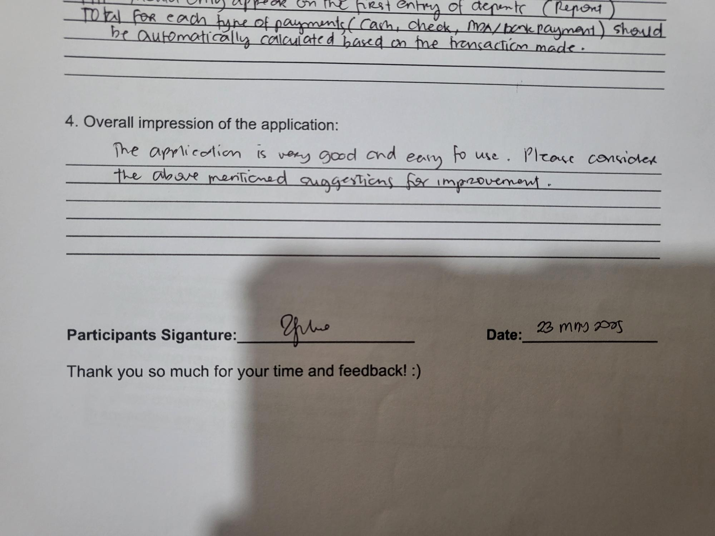
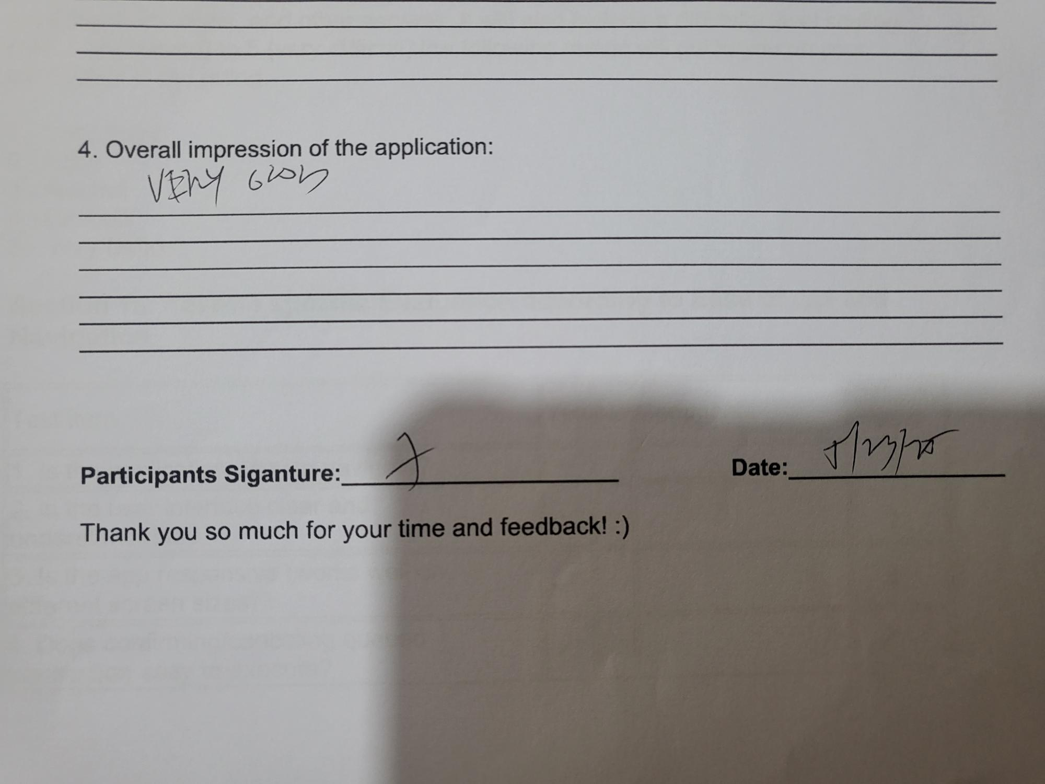
SOME OPEN FEEDBACK IMPRESSIONS FOR THE WEB APPLICATION (CASHIER ADMINISTRATORS)

Slide 25
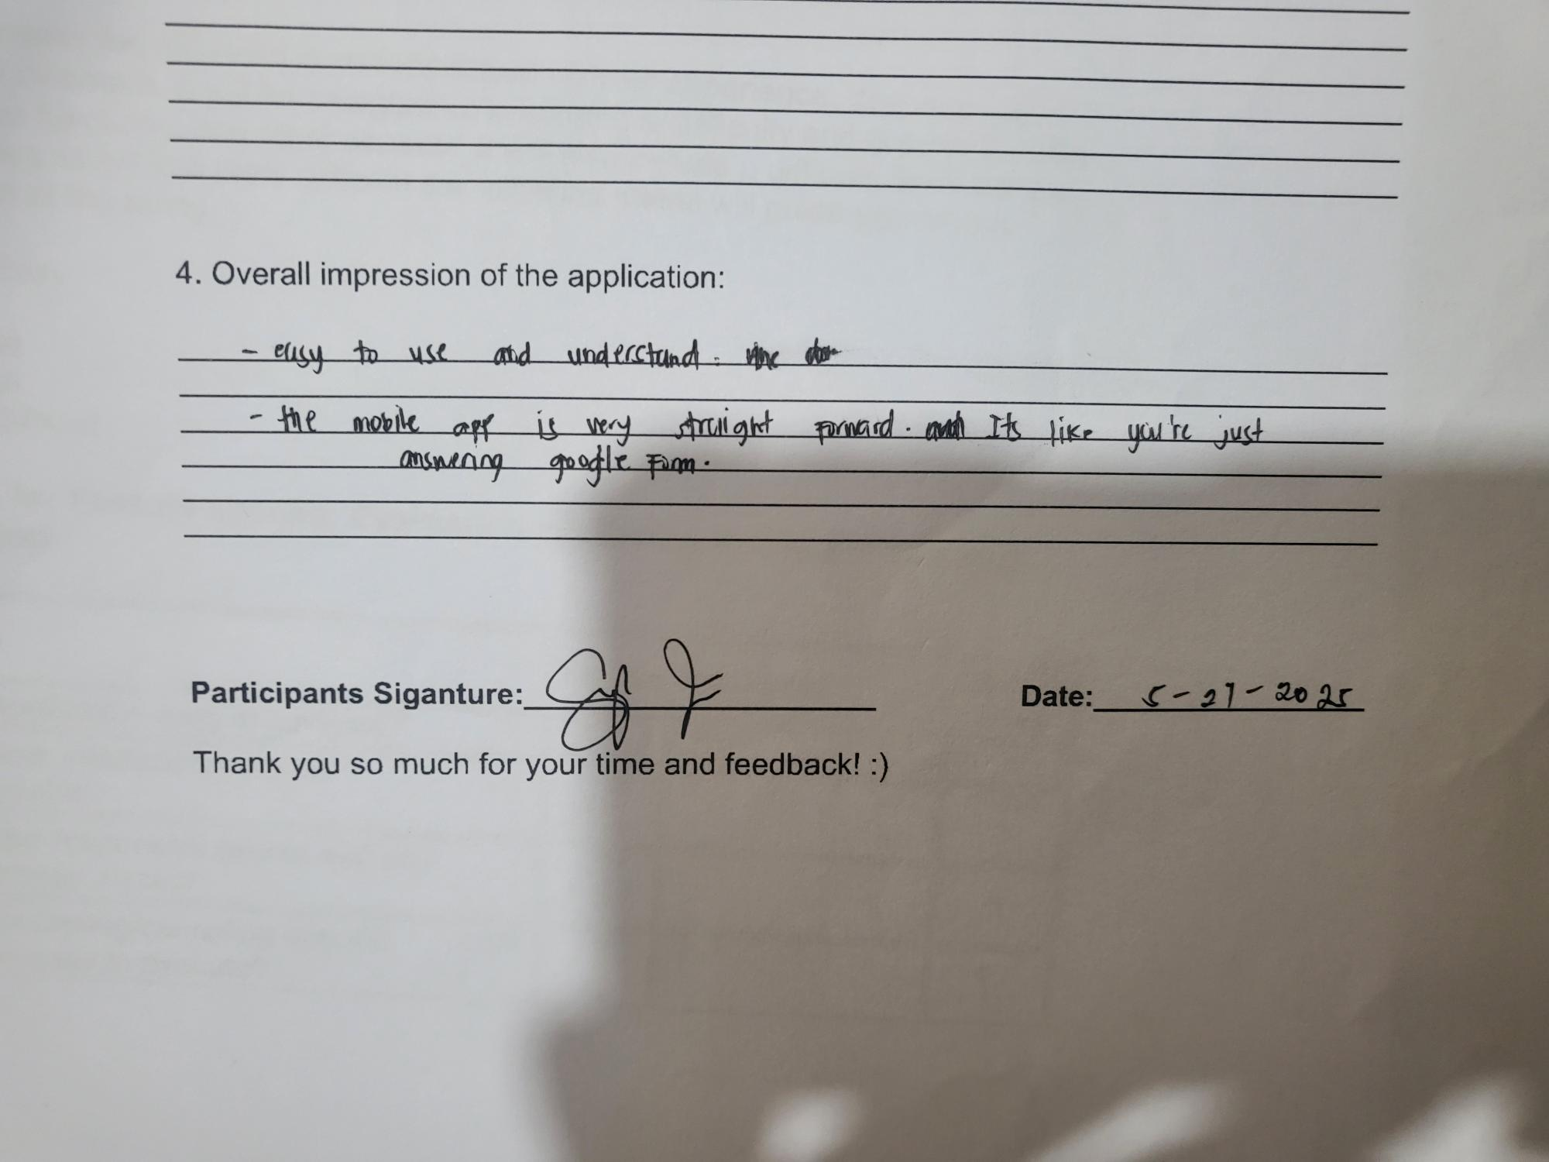
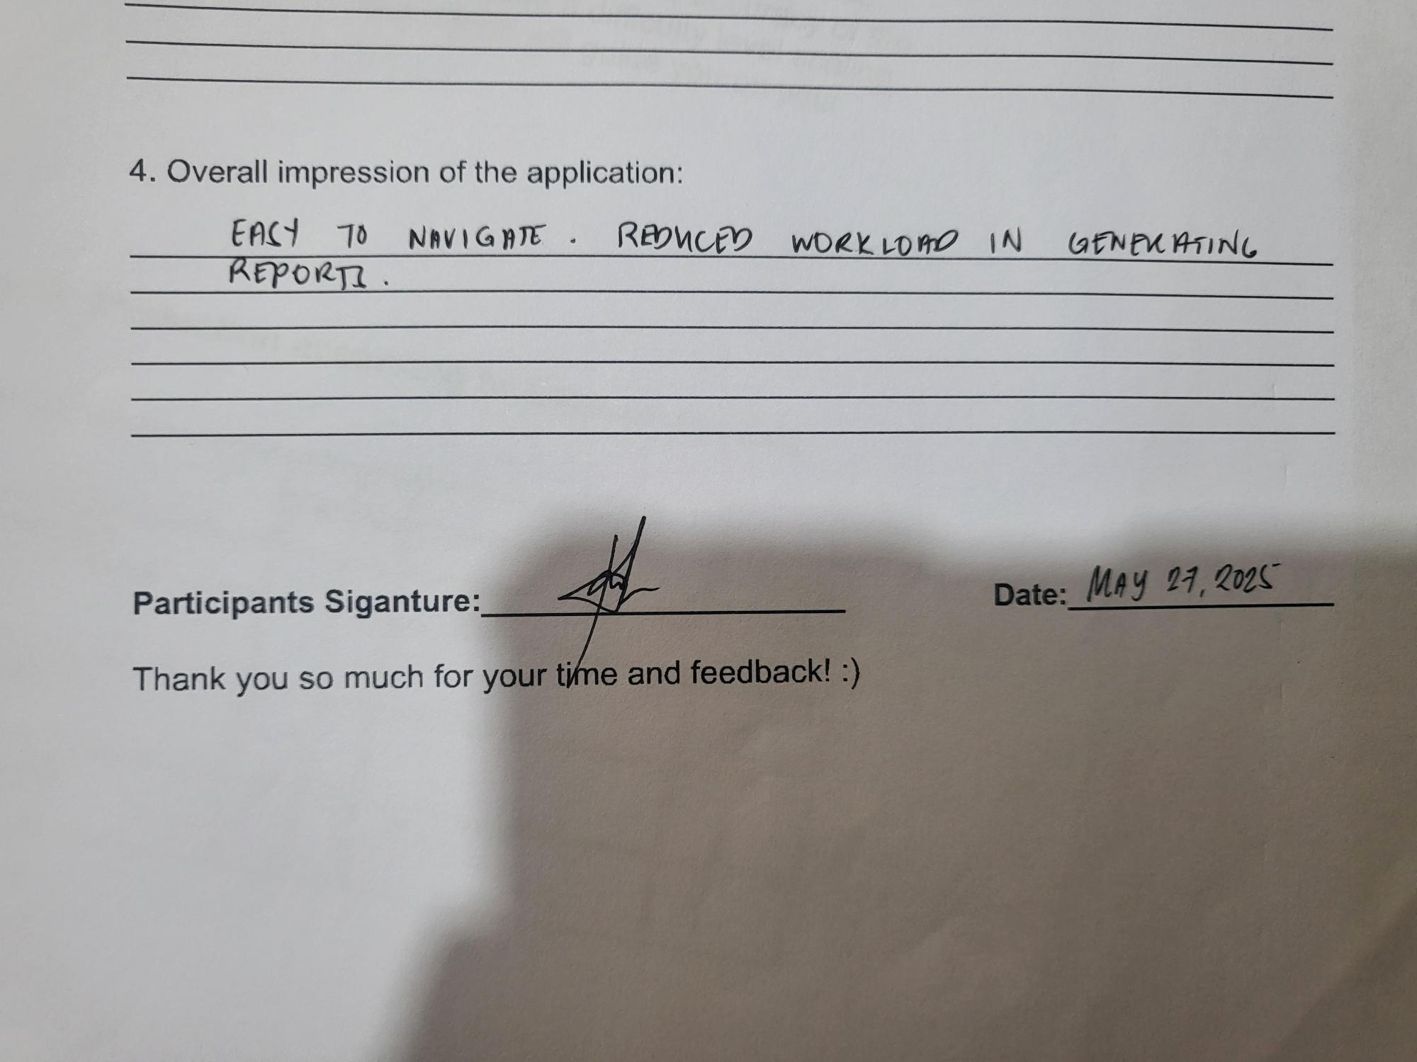
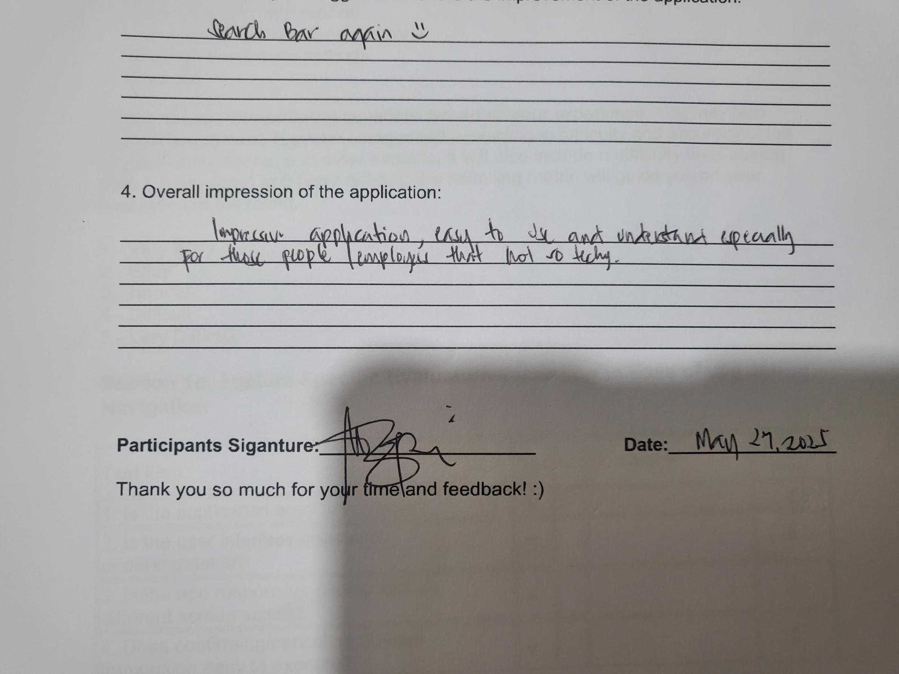
SOME OPEN FEEDBACK IMPRESSIONS FOR THE WEB APPLICATION

Slide 26
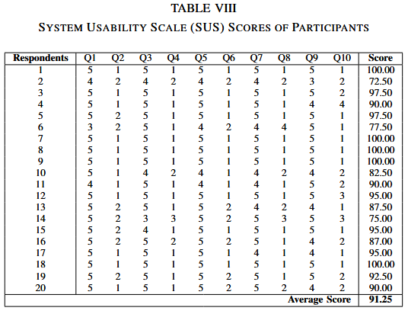
RESULTS MOBILE SUS

Slide 27
CONCLUSION
Successfully developed a web-based application that helps the cashier administrators with day-to-day operations. Its overall impressions was user-friendly, easy to navigate, and generates acceptable output.
Successfully developed a mobile application with an SUS score of 91.25 which indicates that the application is above average

Slide 28
FUTURE WORK
Further improvement on the web-based application UI design.
Advanced web application features such as extended data analytics
Student friendly payment processing on the mobile application

Slide 30
UPLB EASYPAY
Thank you!
Juatco, Jemuel
Institute of Computer Science

